Slide 1


Slide 2
Chapter 1 Introduction to Networks
Network and Security Fundamentals

Slide 3
Objectives
Explain the concept of a Local Area Network (LAN), Wide Area Network (WAN), and Wireless Local Area Network (WLAN)
Explain the different network topologies, access methods, and standards
Identify network devices (Hub, Switch, Router)
Describe Network Addresses (media access control [MAC], internet protocol [IP])

Slide 4
Chapter 1 - Introduction to Networks
What is a network? A Network is two or more nodes connected together to share resources, exchange data, or obtain Internet access. The nodes on a network can be connected via cables, radio waves, or other transmission media.
Different types of networks
LAN-A local area network (LAN) is made up of connected devices that cover a small, single geographic location.
WAN-A wide area network (WAN) is a network that covers a wide geographic area and spans several locations.
WLAN-A Wireless local area network(WLAN) is a wireless network; WLANs provide convenient and secure data communications using radio frequency (RF).

Slide 5
Chapter 1 - Introduction to Networks
LAN, WAN, and WLAN are the most common network types. However, there are other network types that are a little less known. All networks are categorized by the geographic area they occupy, their purpose, and their size.
Some of the different networks based on size are the following:
Metropolitan area network, or MAN Personal area network, or PAN
Some of the different networks based on their purpose are the following:
Virtual private network, or VPN Storage area network, or SAN

Slide 6
Chapter 1 - Introduction to Networks
Network Topologies- A network topology refers to how a network is mapped out or designed. Topologies fall into two categories, physical topologies, and logical topologies.
Types
Star
Bus
Mesh (Partial/Full)

Slide 7

Chapter 1 - Introduction to Networks
Star Topology -The star topology is a network arranged to include a central node that all other devices attach to directly. The central node is also how all devices communicate. The star topology is one of the oldest and most used topologies today.

Slide 8

Chapter 1 - Introduction to Networks
Bus Topology- A bus topology is a network arranged in a way in which all network nodes are connected to one linear cable. A bus topology is an older technology and not used nearly as much as the star. Bus topologies were initially created to connect the internal components of computers with each other.

Slide 9

Chapter 1 - Introduction to Networks
Mesh- A mesh topology is a network arranged in a way in which all network nodes are directly connected to most or all other nodes. Mesh networks are extremely redundant, allowing for data to be transmitted in the event of an outage or if a connection goes down

Slide 10
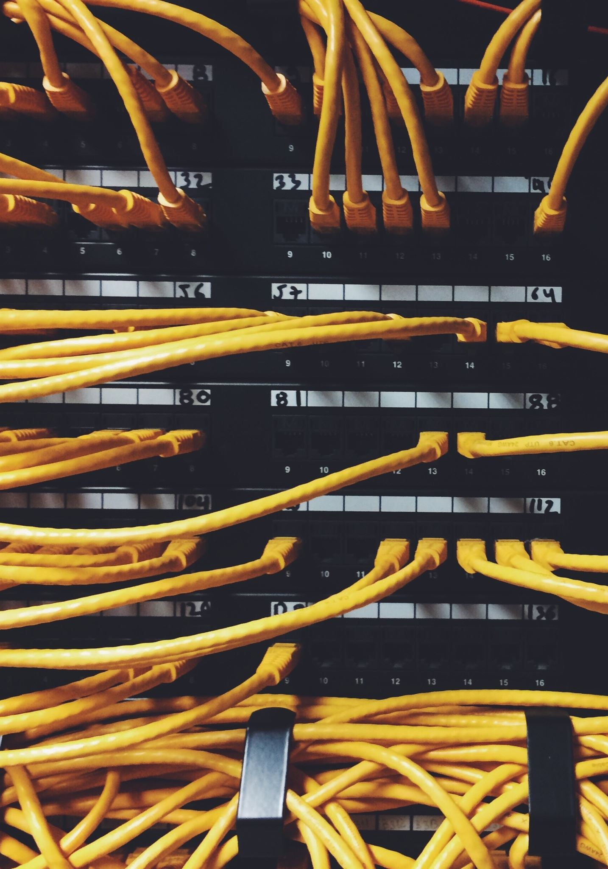
Chapter 1 - Introduction to Networks
Partial Mesh
A partial mesh topology is much more economical and offers less redundancy than a full mesh topology. In a partial mesh topology, at least two of the nodes in the network have links to several other nodes in that network. If one of the main nodes or links in the network fails, the rest of the network continues to function normally.
Full Mesh
A full mesh topology is very expensive and offers more redundancy than most common topologies. In a full mesh topology, every node in the network has a link to each of the other nodes. A full mesh topology is extremely dense since it requires more nodes and is more redundant.

Slide 11
Chapter 1 - Introduction to Networks
Client Server -A client–server network is a network in which one node (the client) requests a resource or service from another node (the server). An easy way to think about this relationship is, a server performs as its name would suggest, and it serves.
Peer to Peer -A peer-to-peer network is a network in which every node can request resource or service from any other node. Often referred to as P2P, a peer-to-peer network offers many advantages. Unlike a client–server network, which may crash if the central server fails, a P2P network can remain operational even if the central server crashes

Slide 12
Chapter 1 - Introduction to Networks
CSMA/CD- CSMA/CD is an algorithm used by Ethernet networks. CSMA/CD helps nodes on the same network segment decide when to send data and how to prevent collisions. This algorithm is most often used in networks with devices such as hubs and repeaters.
CSMA/CA- CSMA/CA functions by sensing the state of the medium with the intention of preventing a collision. A collision happens when two nodes transmit at the same time. CSMA/CA uses signal avoidance instead of detection. CSMA/CA is typically used in wireless networks and CSMA/CD is used in wired networks.

Slide 13
Chapter 1 - Introduction to Networks
IEEE- IEEE stands for the “Institute of Electrical and Electronics Engineers” and is often referred to as “I triple E.” The IEEE is a technical professional organization that defines, develops, and reviews computer science and electronic standards. Its mission is “to foster technological innovation and excellence for the benefit of humanity.” Even though the IEEE is based in the United States, IEEE standards frequently become worldwide standards. Following are two examples of technologies standardized by the IEEE.
802.3 Ethernet
802.11 Wireless (Wi-Fi)

Slide 14
Chapter 1 - Introduction to Networks
Network Devices
Hub- A network hub is an open systems interconnection (OSI) layer 1 device used to connect other devices in a LAN. Hubs are older network devices and have been replaced by switches in most star topologies.
Switch- A network switch is an OSI layer 2 device. Switches are devices used to connect other devices in a LAN. Today switches are most commonly used as the central node in a star topology.
Router- A network router is an OSI layer 3 device. Routers are devices used to connect networks or LANs and enable networks to route traffic from one network to the other.

Slide 15

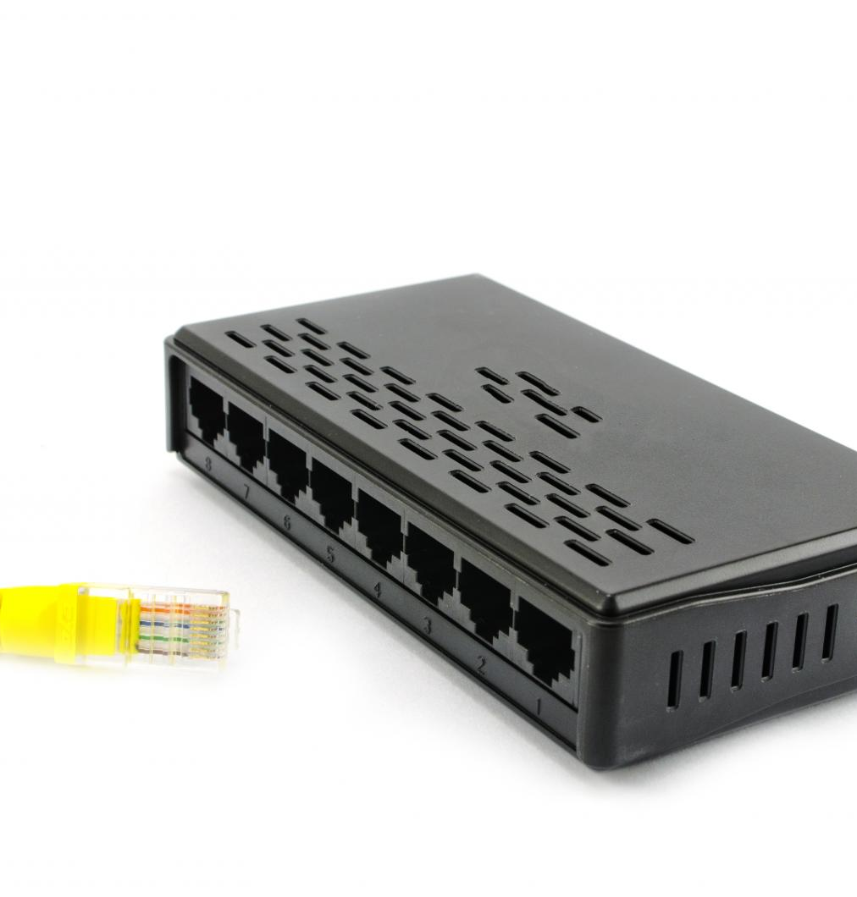
Chapter 1 - Introduction to Networks
Network Hub
Layer 1 Device
No forwarding intelligence(dumb device)
Small LANs

Slide 16
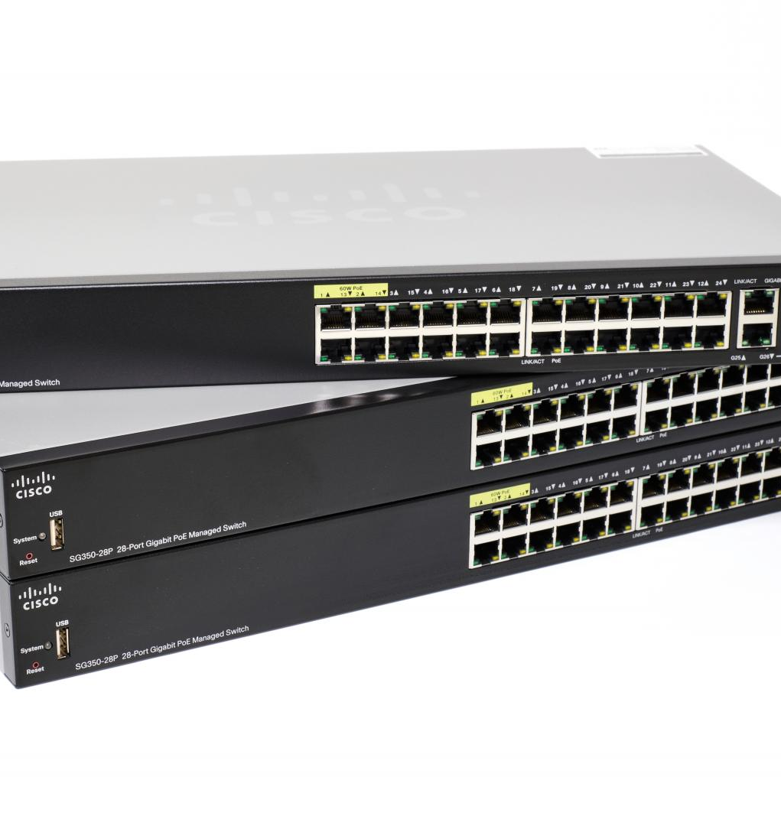
Chapter 1 - Introduction to Networks
Network Switch
Layer 2 Device(primarily) or Layer 3
Forwards Frames based on MAC address
VLANs
MAC/CAM Table

Slide 17
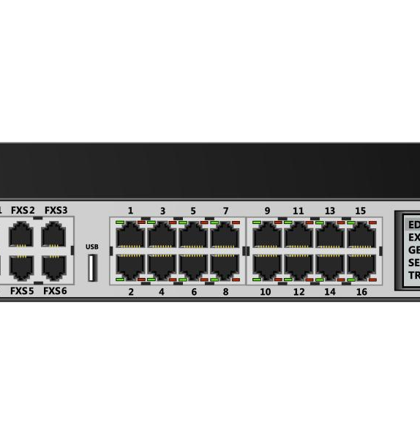
Chapter 1 - Introduction to Networks
Router
Layer 3 Device Routes information based on IP address
Routing Table/ Routing Decisions

Slide 18
Chapter 1 - Introduction to Networks
Network Addresses
MAC Address- MAC addresses are used to individually identify a host on an Ethernet network. Each host’s NIC has a MAC address burned into its firmware. This is the reason MAC addresses are referred to as Burned-in-addresses (BIA) or often known as hardware addresses.
MAC addresses are 48 Bits/6 Bytes long.
IP Address- There are two types of IP address; IP Version 4 (IPv4) and IP Version 6 (IPv6). IPv4 uses 32 binary bits to create a unique address on the network. IPv6 uses a 128-bit address, theoretically allowing 2,128, or approximately 3.4 × 1,038 addresses.

Slide 19
Chapter 1 - Introduction to Networks
MAC Address
00:1A:C2:7B:00:47
IP address
V4
192.168.1.1
V6
2001:0db8:85a3:0000:0000:8a2e:0370:7334

